Slide 1
Recycling in Arlington County
Glencarlyn Civic Association
Monday, April 10th, 2023

Slide 2
Topics for Discussion
What is recycling?
Triangle Symbols- What do the numbers mean?
What to recycle in Arlington
How does it work in Arlington?
What happens to my recycling after collection?
Economics of recycling
Environmental benefits and fun facts
Test your recycling knowledge
Composting overview
Q + A

Slide 3
What is recycling?
Recycling (n.) – the action or process of converting waste into reusable materials

Slide 4
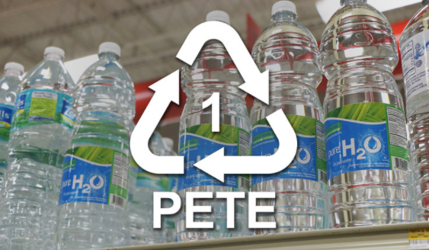
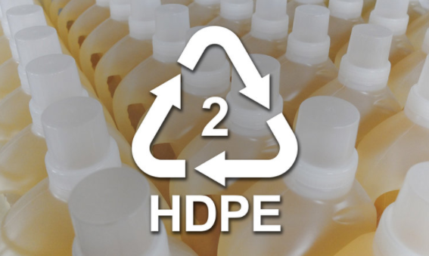
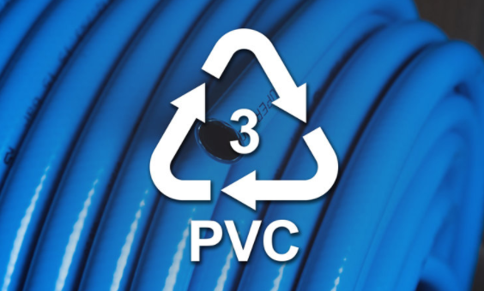
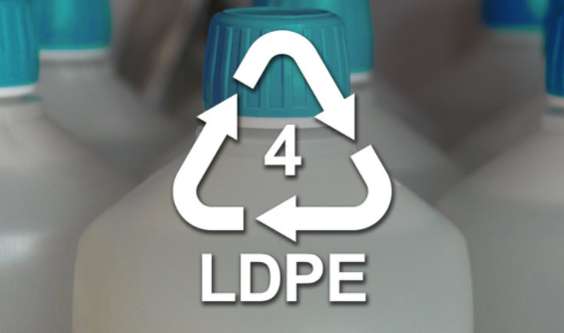
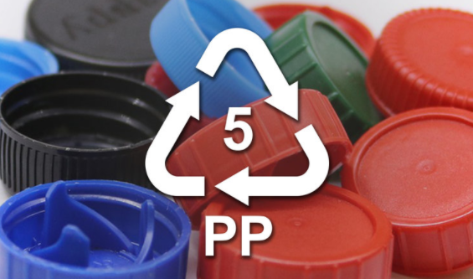
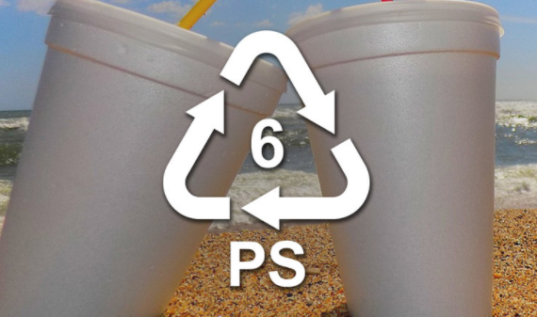
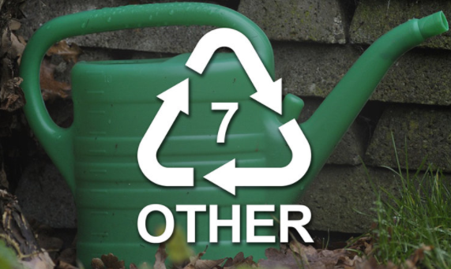
Triangle Symbols – What do the numbers mean?
This design was created in 1970 as part of a student contest tied to the very first Earth Day.
The numbers you see on recycling triangle symbols represent the type of resin used to make the plastic.
1 – PETE – Polyethylene Terephthalate
2 – HDPE – High density Polyethylene
3 – PVC – Polyvinyl Chloride
4 – LDPE – Low-density Polyethylene
5 – PP – Polypropylene
6 – PS – Polystyrene
7 – Other
https://www.hebrongoesgreen.com/recycling-symbols

Slide 5
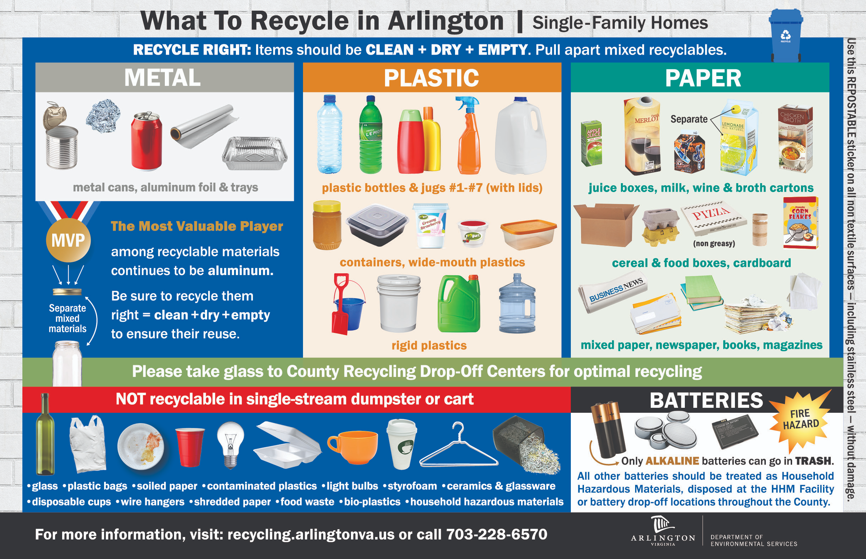

Slide 6
How does it work in Arlington?

Slide 7
What happens to my recycling after collection?
Arlington County contractors collect recycling from the curb
Collected materials are taken to a Materials Recovery Facility (MRF)
Arlington pays a “tipping fee” to the MRF
Fee is calculated based on commodities prices and approximate composition of the load based on previous waste audits
MRF sorts, processes and markets the materials for sale
After materials are sold, a percentage of profits are returned to the county as credit at the MRF

Slide 8
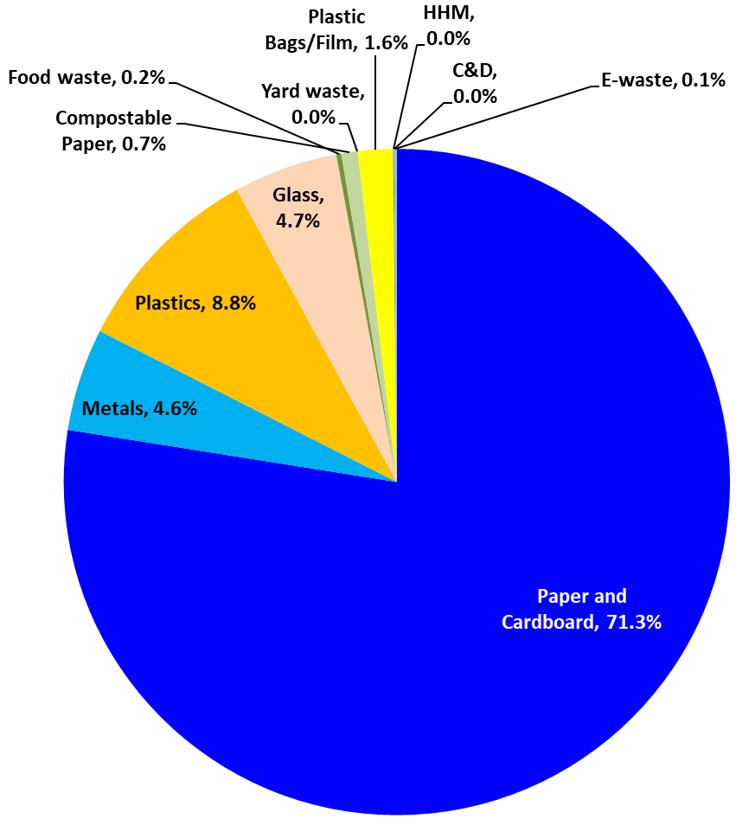
Economics of Recycling
Arlington’s average recycling collection consists of approximately 90% recyclable materials
This means only 10% of what’s put in Arlington’s recycling doesn’t belong
Recycling commodities sales are able to be credited to cover tipping fees where trash collection cannot
Bottom line: Recycling costs less than trash
Commodities prices are always fluctuating
Recycling in Arlington makes economic sense

Slide 9
Environmental benefits of recycling
Reduces amount of waste sent to landfills/incinerators
Conserves natural resources like timber, water and minerals
Reduces greenhouse gas emissions that contribute to global climate change
Helps sustain the environment for future generations
Reduces need to process virgin materials, saving energy
source: epa.gov

Slide 10
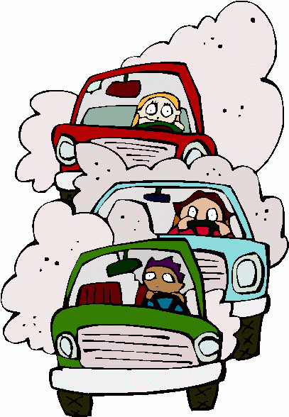
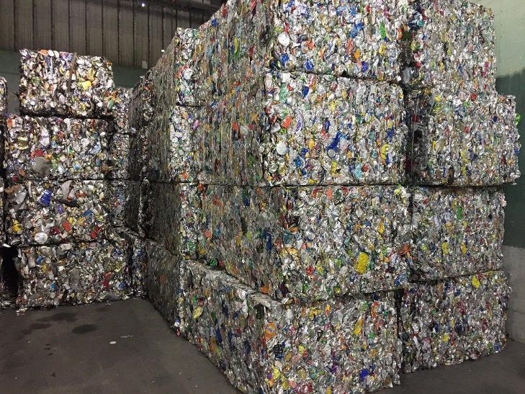
Fun facts
If U.S. recycling levels reached 75% it would be the equivalent, in CO2 reduction, of removing 55 million cars from U.S. roads each year and would generate 1.5 million new jobs.
Five plastic bottles (PET) recycled provides enough fiber to create one square foot of carpet or enough fiber to fill one ski jacket.
Every three months, Americans throw enough aluminum into landfills to build our nation’s entire commercial air fleet.
source: recycleacrossamerica.com

Slide 11
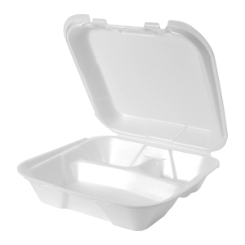
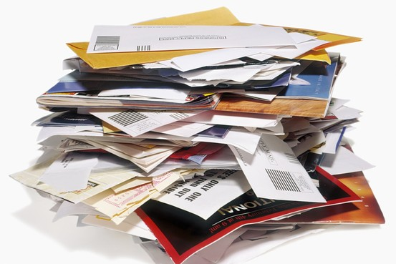
Test your knowledge – true or false?

Slide 12
Test your knowledge - results
FALSE
TRUE
FALSE
FALSE
FALSE

Slide 13
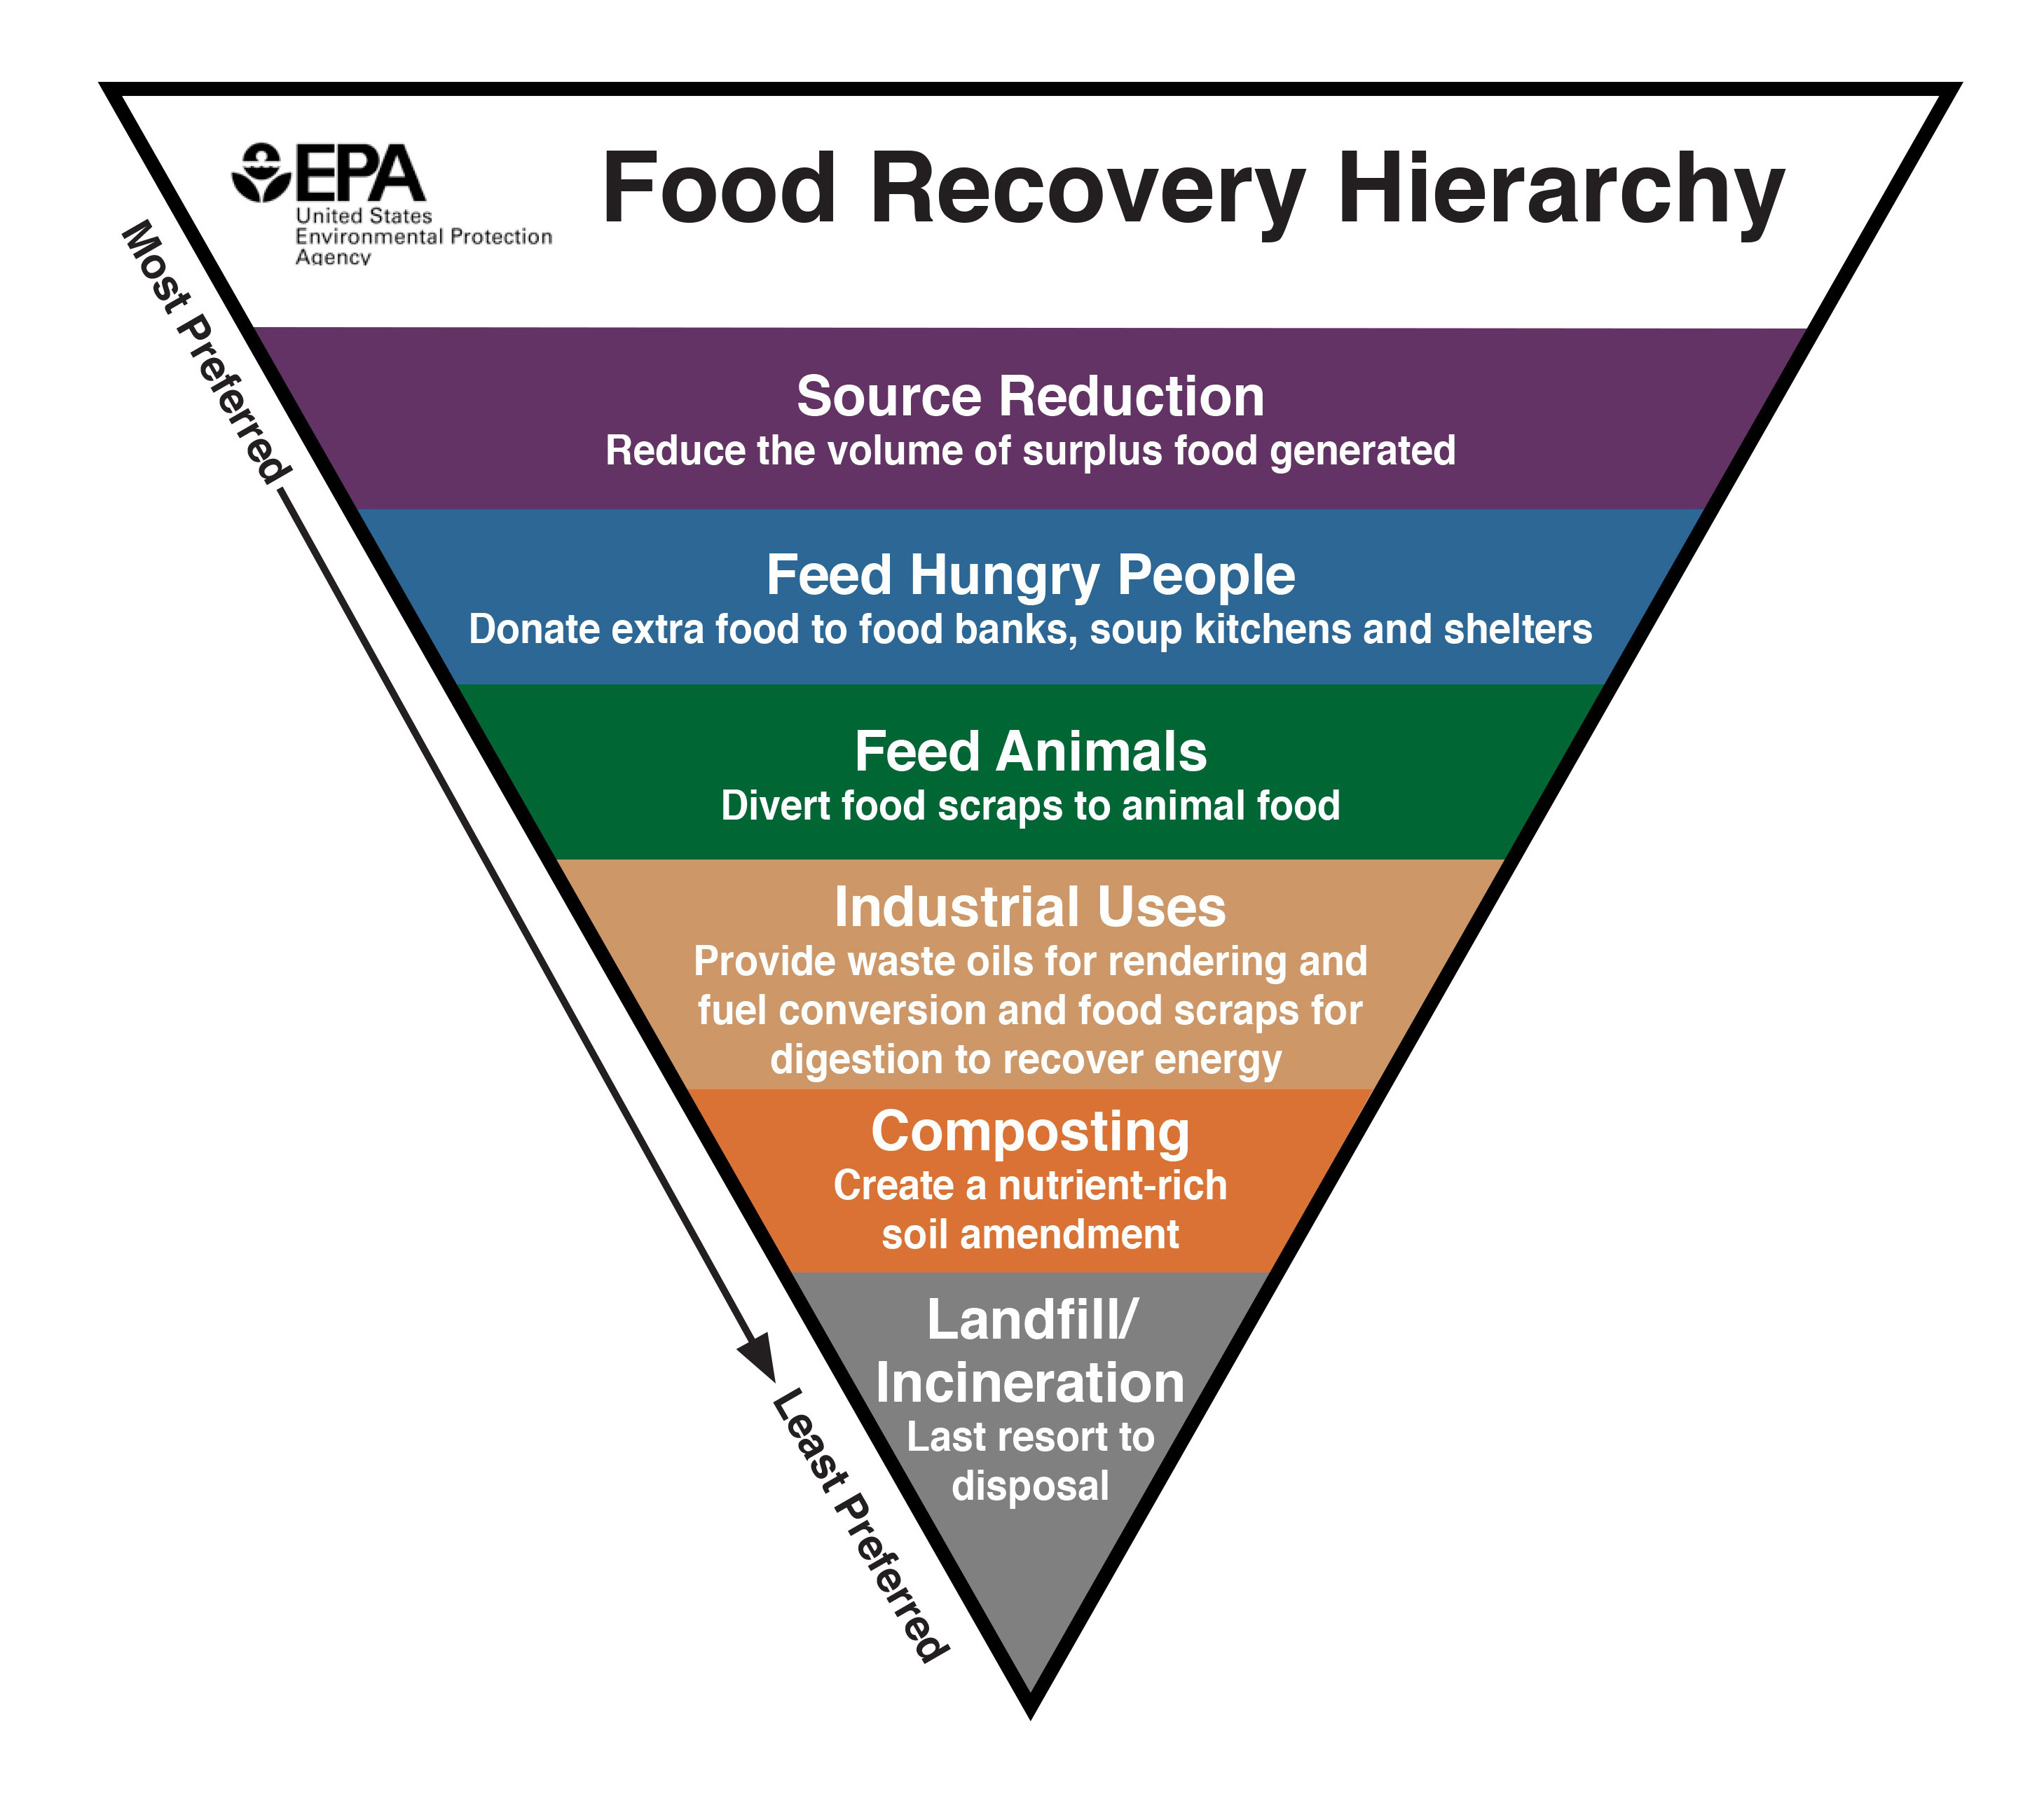
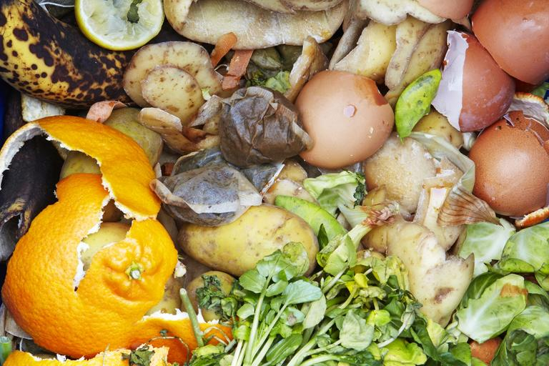
The Benefits of Composting
What are some benefits to composting?
Helps reduce overall food waste
Conserves energy and resources
Reduces methane gas emissions
?

Slide 14
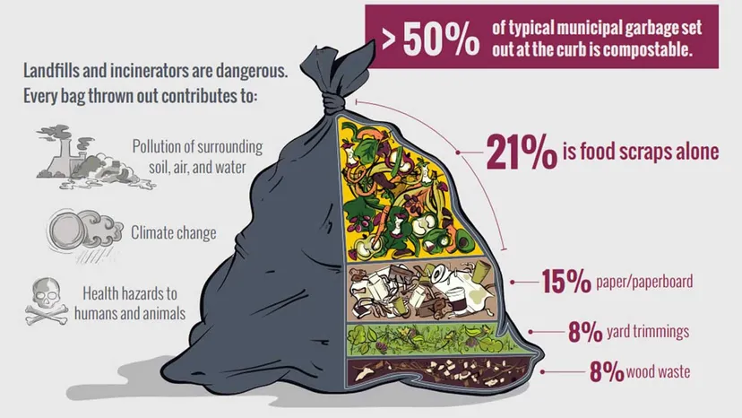
How much is being thrown away?
source: epa.gov

Slide 15
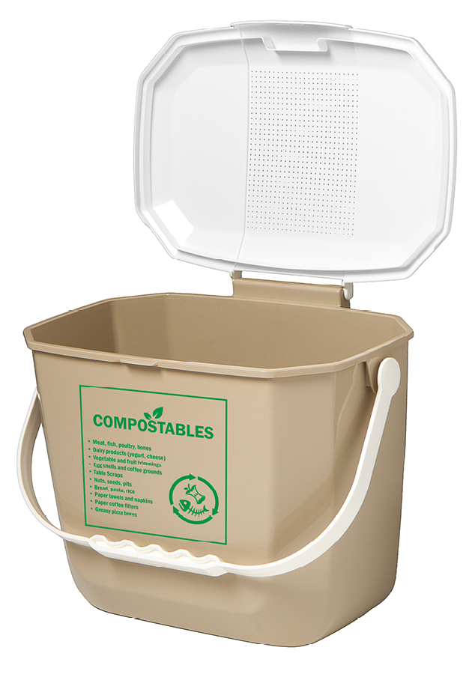
Composting in Arlington
A good rule of thumb for composting in Arlington is: If it grows, it goes!
Greasy pizza boxes and soiled paper products like napkins and paper towels are also accepted
“Compostable” hard plastics (i.e. utensils, takeout containers) will not be accepted
Don’t receive county curbside service? Compost can also be taken to Arlington’s Earth Recycling Yard

Slide 16
Questions
?

